Slide 1
Operating System Structures
Chapter #2
Course Instructor: Safia Baloch

Slide 2
Chapter Objectives
Identify services provided by an operating system
Illustrate how system calls are used to provide operating system services
Compare and contrast monolithic, layered, microkernel, modular, and hybrid strategies for designing operating systems
Illustrate the process for booting an operating system
Apply tools for monitoring operating system performance
Design and implement kernel modules for interacting with a Linux kernel

Slide 3
Operating System Services
One set of operating-system services provides functions that are helpful to the user:
User interface - Almost all operating systems have a user interface (UI).
Varies between Command-Line (CLI), Graphics User Interface (GUI), Batch
Program execution - The system must be able to load a program into memory and to run that program, end execution, either normally or abnormally (indicating error)
I/O operations - A running program may require I/O, which may involve a file or an I/O device

Slide 4
Operating System Services (Cont.)
File-system manipulation - The file system is of particular interest. Programs need to read and write files and directories, create and delete them, search them, list file Information, permission management.
Communications – Processes may exchange information, on the same computer or between computers over a network
Communications may be via shared memory or through message passing (packets moved by the OS)
Error detection – OS needs to be constantly aware of possible errors
May occur in the CPU and memory hardware, in I/O devices, in user program
For each type of error, OS should take the appropriate action

Slide 5
Operating System Services (Cont.)
Resource allocation - When multiple users or multiple jobs running concurrently, resources must be allocated to each of them
Many types of resources - CPU cycles, main memory, file storage, I/O devices.
Accounting - To keep track of which users use how much and what kinds of computer resources
Protection and security - The owners of information stored in a multiuser or networked computer system may want to control use of that information, concurrent processes should not interfere with each other
Protection involves ensuring that all access to system resources is controlled
Security of the system from outsiders requires user authentication, extends to defending external I/O devices from invalid access attempts

Slide 6
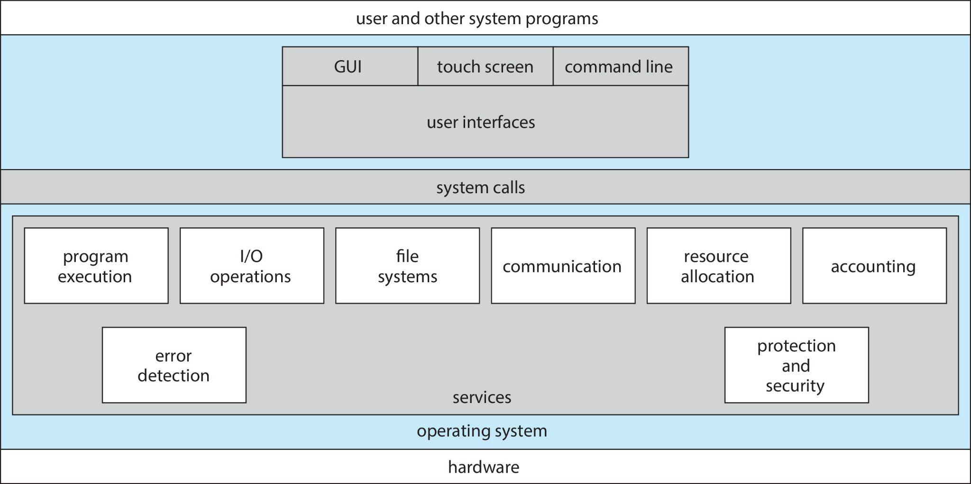
A View of Operating System Services

Slide 7
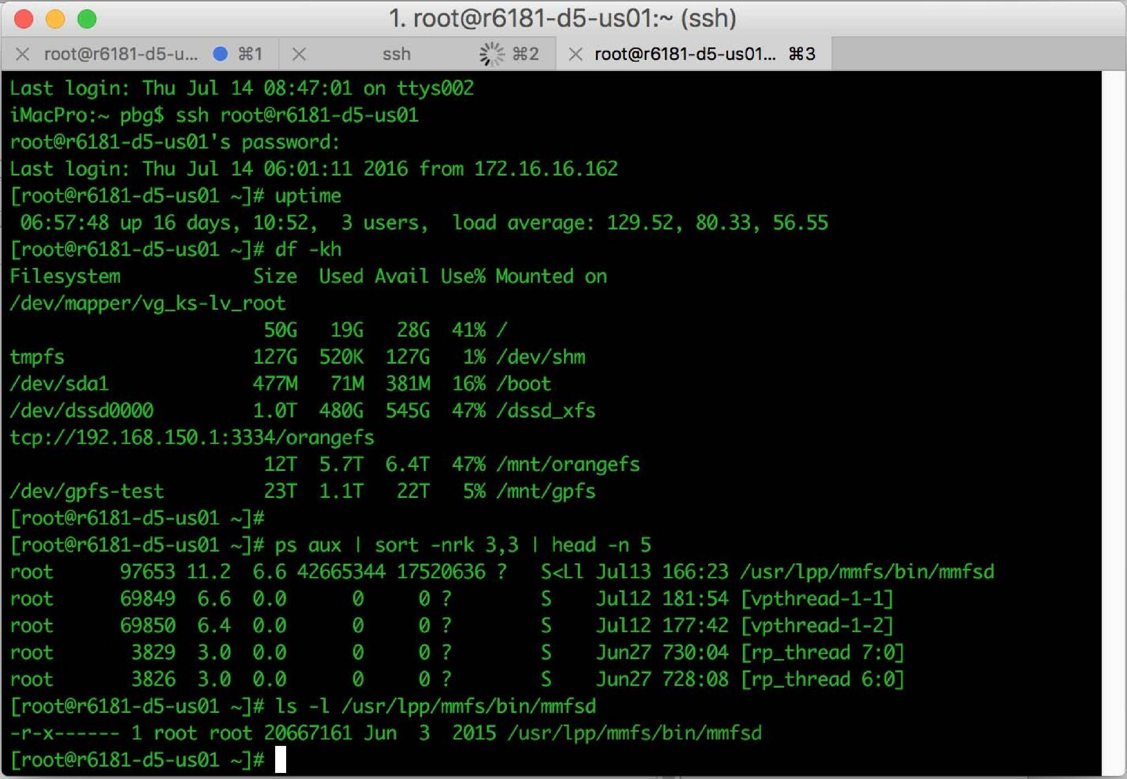
User Operating System Interface - CLI
These interfaces are NOT normally considered a direct function of the operating system.
CLI or command interpreter allows direct command entry
Sometimes multiple flavors implemented – shells
Primarily fetches a command from user and executes it
Sometimes commands built-in, sometimes just names of programs

Slide 8
User Operating System Interface - GUI
User-friendly desktop metaphor interface
Usually mouse, keyboard, and monitor
Icons represent files, programs, actions, etc
Various mouse buttons over objects in the interface cause various actions (provide information, options, execute function, open directory (known as a folder)
Many systems now include both CLI and GUI interfaces
Unix and Linux have CLI with optional GUI interfaces (CDE, KDE, GNOME)

Slide 9

Touchscreen Interfaces
Touchscreen devices require new interfaces
Mouse not possible or not desired
Actions and selection based on gestures
Virtual keyboard for text entry
Voice commands.
Which one is better or why?
Notes:
Command Interpreters are powerful for doing many challenging tasks, but require rather a long time to learn.
GUIs and Touch-Screen Interfaces make it easy to learn how to perform commonly-needed tasks.

Slide 10
System Calls
What is system call?
"System calls" is very much the answer to the question, "What does the operating system do?"
Programming interface to the services provided by the OS
Typically written in a high-level language (C or C++)
Mostly accessed by programs via a high-level Application Programming Interface (API) rather than direct system call use
Three most common APIs are Win32 API for Windows, POSIX API for POSIX-based systems (including virtually all versions of UNIX, Linux, and Mac OS X), and Java API for the Java virtual machine (JVM)

Slide 11
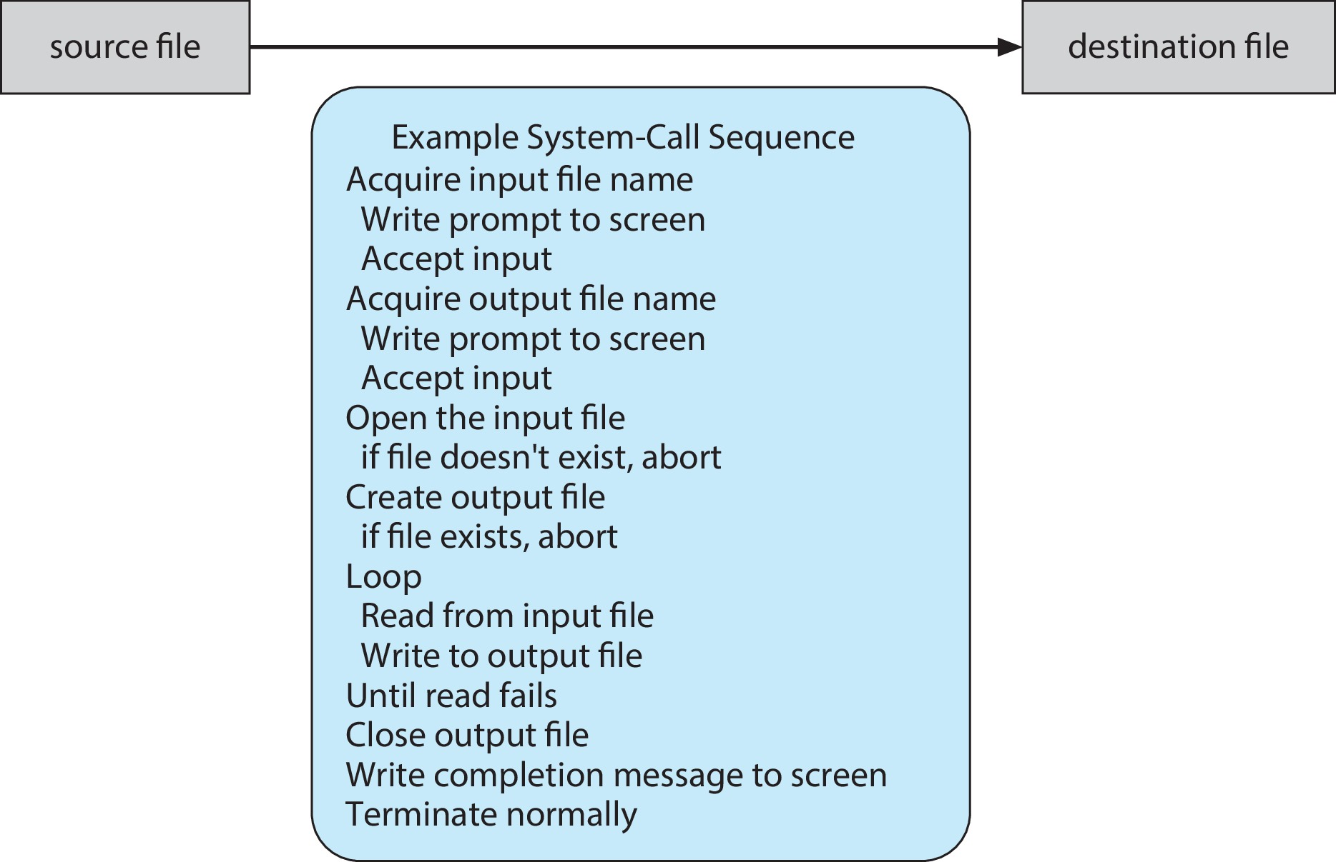
Example of System Calls
How a simple program that makes a copy of a file has to make a large number of system calls, involving keyboard, screen, and disk I/O.

Slide 12
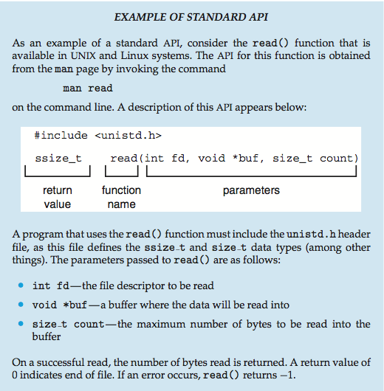
Example of Standard API
Notes:
Low level programmer(OS developer) do NOT put system calls in their program.
Instead they use an API which provides library functions.
When a process calls API function, API makes whatever system calls are necessary.
API benefit: easy to port programs from one kind of computer to a different kind.
Such as Windowa API, POSIX API, Java API

Slide 13

API – System Call – OS Relationship
Notes:
Typically, there is a number associated with each system call. To implement a system call, the requesting process executes an instruction that causes a trap.
The trap puts an OS handler into the CPU.
The OS handler looks up the system call number in a table maintained by the OS.
The table entry tells the OS which piece of code it has to execute to perform the system call, and the OS then executes that code.

Slide 14
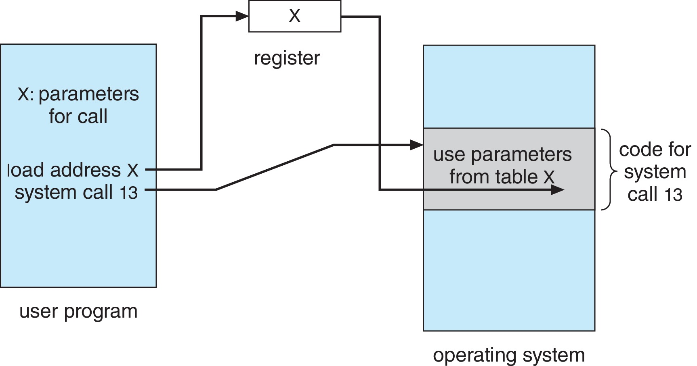
System Call Parameter Passing via Table
Notes:
important detail: A process can pass parameters to a system call by leaving them in CPU registers, by leaving them in a RAM block (pointed to by an address in a register), or by pushing them onto the runtime stack.

Slide 15
System Call Parameter Passing
Three general methods used to pass parameters to the OS
Simplest: pass the parameters in registers
Parameters stored in a block, or table, in memory, and address of block passed as a parameter in a register
Parameters placed, or pushed, onto the stack by the program and popped off the stack by the operating system
Notes:
Pass parameters into register if not more than five else Stored in block or table in memory.
Then address of a block is passed as parameter into register.
Block vs bytes:
512 byte = 1 block
2 block = 1024 byte = 1 kb
2048 block = 1024 kb = 1 mb
2097152 block = 1024 mb = 1 gb

Slide 16
Types of System Calls
System calls can be roughly grouped into
Six major categories:
Process Control
File management
Device Management
Information Maintenance
Communication
Protection(allow_user and deny_user)

Slide 17
Types of System Calls
1.Process Control
Examples are:
create process,
terminate process,
load process,
execute process,
get/set process attributes,
wait for event,
signal event, allocate/free memory.
Notes:
Allocation of time.
Attributes.
Lock shared data between two process.

Slide 18
Types of System Calls
2.File management
create file, delete file
open, close
read, write, reposition
get/set file attributes (Same for folders or directories)
3.Device Management
request device, release device
read, write, reposition
get/set device attributes
logically attach or detach devices
Notes:
In device management: if resources are available , they are granted
Resources: files, disk drivers
If system allow unmanaged access to devices, What happens?

Slide 19
Types of System Calls
4.Information Maintenance
get/set time or date
get/set system data
get/set process, file, or device attributes
5.Communication
create, delete communication connection
send, receive messages
transfer status information
attach or detach remote device
Notes:
Communication: directly or indirectly through mailbox
Shared memory

Slide 20
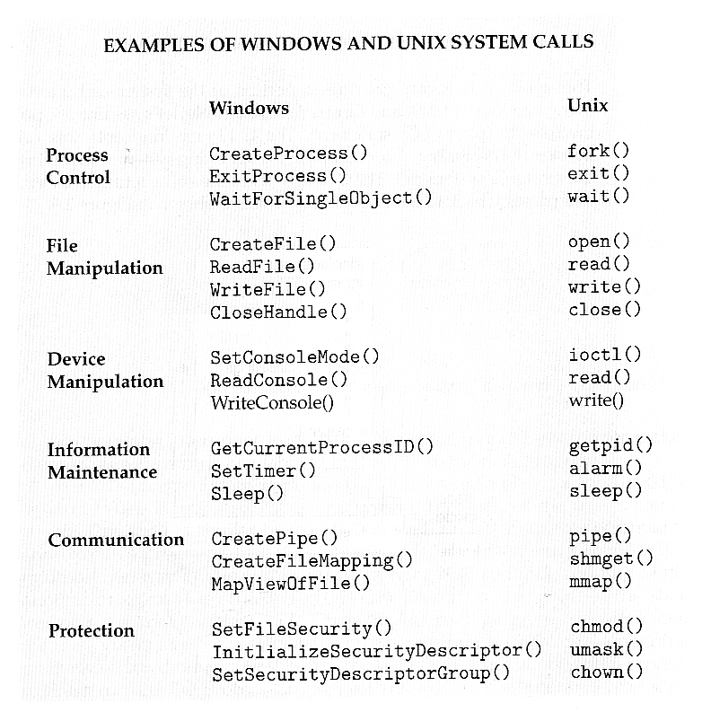

Slide 21
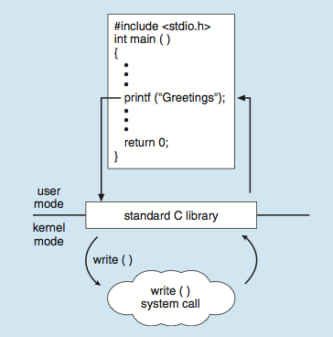
Standard C Library Example
C program invoking printf() library call, which calls write() system call

Slide 22
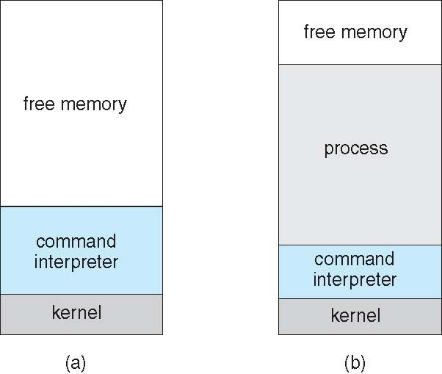
Example: MS-DOS
Single-tasking
Shell invoked when system booted
Simple method to run program
Single memory space
At system startup running a program

Slide 23
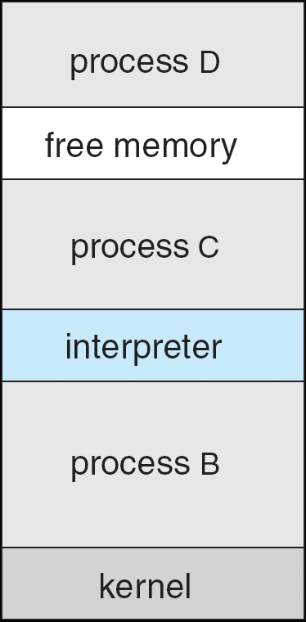
Example: FreeBSD(Berkeley Software Distribution)
Unix variant
Multitasking
User login -> invoke user’s choice of shell
Shell executes fork() system call to create process
Executes exec() to load program into process
Shell waits for process to terminate or continues with user commands
Process exits with:
code = 0 – no error
code > 0 – error code

Slide 24
System Programs
System programs provide a convenient environment for program development and execution. They can be divided into:
File manipulation
Status information sometimes stored in a File modification
Programming language support
Program loading and execution
Communications
Background services
Application programs
Notes:
The important factor in handling system calls is RTE(run time environment)-full suite of software such as compilers, interpreter, libraries, loaders.
RTE provides system call interface.

Slide 25
System Programs
File management - Create, delete, copy, rename, print, dump, list, and generally manipulate files and directories
Status information
Some ask the system for info - date, time, amount of available memory, disk space, number of users
Others provide detailed performance, logging, and debugging information
Notes:
All system calls such as create(), read(), write() open() come into file maagment

Slide 26
System Programs (Cont.)
File modification
Text editors to create and modify files
Special commands to search contents of files or perform transformations of the text
Programming-language support - Compilers, assemblers, debuggers and interpreters sometimes provided
Program loading and execution- debugging systems for higher-level and machine language
Communications - Provide the mechanism for creating virtual connections among processes, users, and computer systems

Slide 27
System Programs (Cont.)
Background Services
Launch at boot time
Provide facilities like disk checking, process scheduling, error logging, printing
Run in user context not kernel context
long-running specialized server processes, known as services, subsystems, daemons
Application programs
Run by users

Slide 28
Linkers and Loaders
Source code compiled into object files designed to be loaded into any physical memory location – relocatable object file
Linker combines these into single binary executable file
Program resides on secondary storage as binary executable
Must be brought into memory by loader to be executed
Relocation assigns final addresses to program parts and adjusts code and data in program to match those addresses
Modern general purpose systems don’t link libraries into executables
Rather, dynamically linked libraries (in Windows, DLLs) are loaded as needed, shared by all that use the same version of that same library (loaded once)
Object, executable files have standard formats, so operating system knows how to load and start them
Notes:
LINKER: Source->compile->object file->relocatable object file -> linker (libraries )
Whole activity of loader and linking is relocation: it assign final address for code parts.

Slide 29
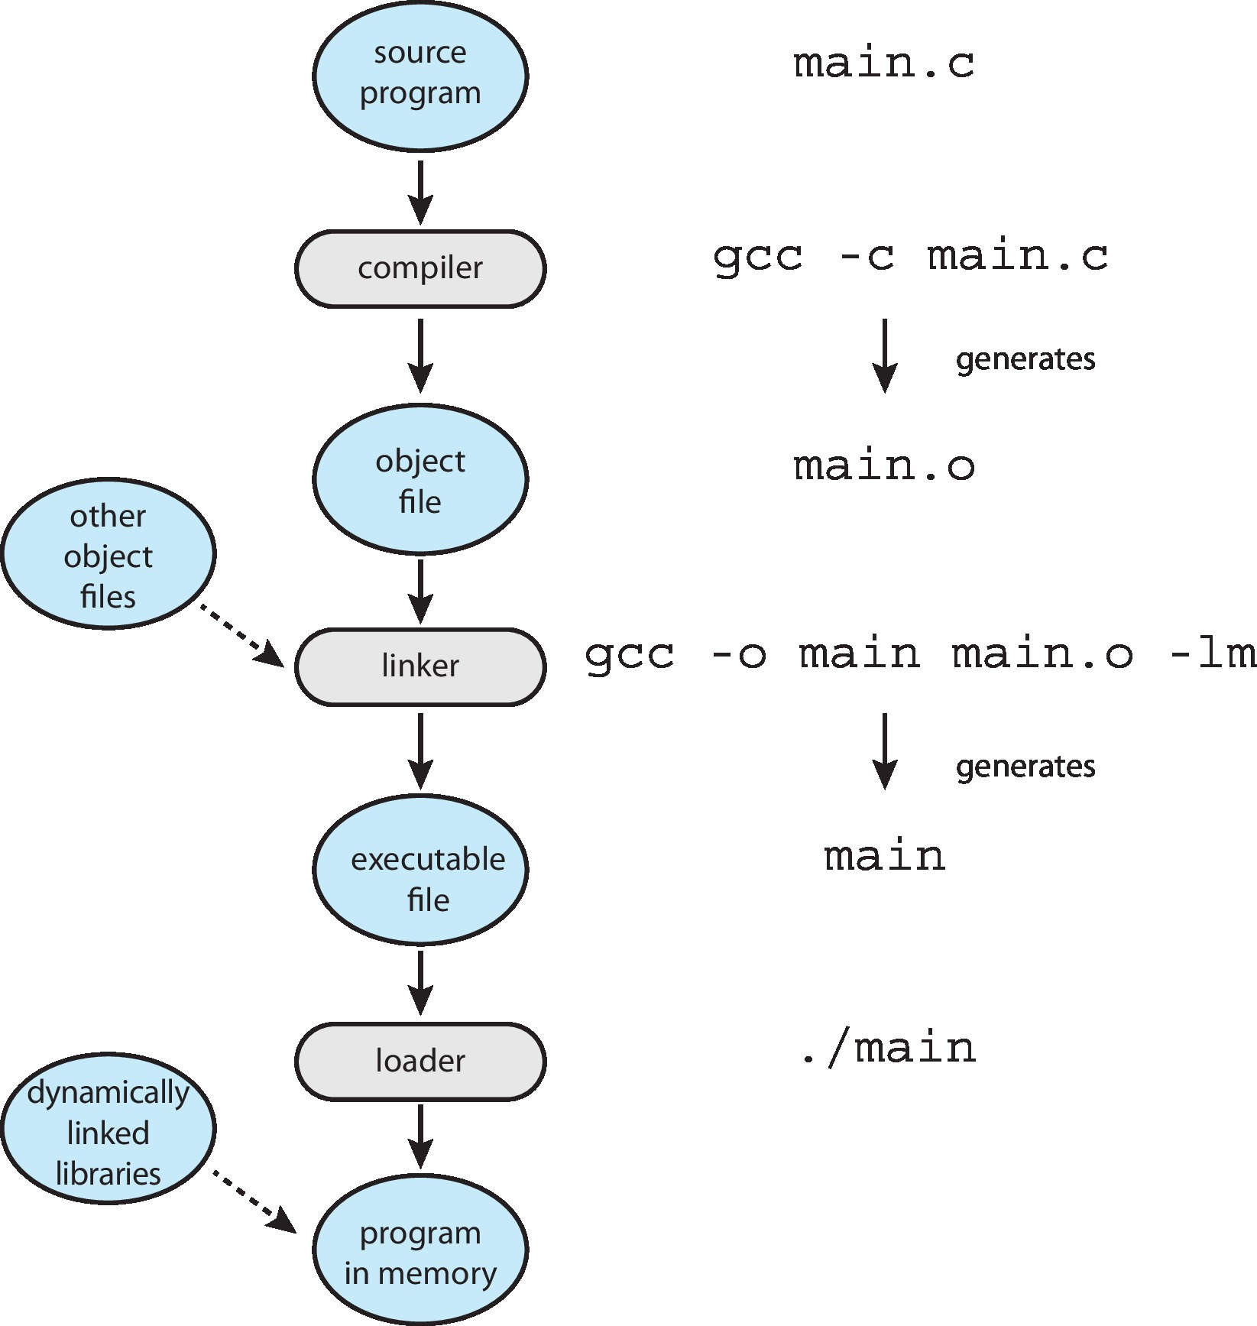
The Role of the Linker and Loader

Slide 30
The role of the linker and loader
The job is complex.
One reason is that most programs are really made of different pieces of code written at different times and stored in different files.
Another reason is that it is often necessary to move pieces of running programs from one place in memory to a different place.
Also, a particular part of a program may not be needed every time the program executes. So the OS may delay loading some parts until they are needed.

Slide 31
Why Applications are Operating System Specific
Apps compiled on one system usually not executable on other operating systems(windows, linux IOS soft)
Because each operating system provides its own unique system calls
Own file formats, etc
Apps can be multi-operating system
Written in interpreted language like Python, Ruby, and interpreter available on multiple operating systems
App written in language that includes a VM containing the running app (like Java)
Use standard language (like C), compile separately on each operating system to run on each
Application Binary Interface (ABI) is architecture equivalent of API, defines how different components of binary code can interface for a given operating system on a given architecture, CPU, (address width, methods to pass parameters, binary format of libraries etc))
Notes:
Upper level
1:Specific feature sets available in os for applications
2: Application requirement (run time environment ) jvm (jre sdk) windows,linux etc
3:API, posix
Lower level:
Binary file
Compatible instruction set of app with cpu
Difference in system call activities.
Api at app level(Posix) vs api at architecture level (App binary interface)
ABI( address width, methods to pass parameters, binary format of libraries etc)

Slide 32
Operating System Design and Implementation
Start the design by defining goals and specifications
Affected by choice of hardware, type of system
User goals and System goals
User goals – operating system should be convenient to use, easy to learn, reliable, safe, and fast
System goals – operating system should be easy to design, implement, and maintain, as well as flexible, reliable, error-free, and efficient
Notes:
Q: Desirable System goals vs user goals

Slide 33
Operating System Design and Implementation (Cont.)
Important principle to separate
Policy: What will be done? Mechanism: How to do it?
Mechanisms determine how to do something, policies decide what will be done
computing system tends to be more flexible if we build in mechanisms that can support a range of policies. (example – timer)
Notes:
Separation of policy and mechanism
Mechanism : how to do sth(timer construct for cpu protection )
Policy: what will be done(how long timer)

Slide 34
Implementation
Much variation
Early OSes in assembly language
Then system programming languages like Algol, PL/1
Now C, C++
modern operating systems are written almost entirely in a high-level programming language such as C.
There are some things that just can't be done with high-level language statements, for example some device-driver code and instructions that save and restore register values.
Advantages for high level language:
code is developed faster; is smaller, easier to understand, debug and change; and easier to port.
Actually usually a mix of languages
Lowest levels in assembly
Main body in C
Systems programs in C, C++, scripting languages like PERL, Python, shell scripts
Emulation can allow an OS to run on non-native hardware
Notes:
Android emulator

Slide 35
As the authors say:
"As is true in other systems, major performance improvements in operating systems are more likely to be the result of better data structures and algorithms than of excellent assembly-language code."

Slide 36

Principles of data structures are also applied in OS.
Notes:
Information Hiding,
Modularity

Slide 37
Operating System Structure
There are six different structures:
Simple Structure(monolithic )
Layered Systems
Microkernels
Modules
Hybrid Machines

Slide 38
Operating System Structure
1.Monolithic Structure:
DOS(disk OS) has no modern software engineering techniques,
Does not break the system into subsystems, and has no distinction between user and kernel modes.
Allow all programs direct access to hardware.
Because monolithic kernel is a single, static, binary file that runs in a single address space
Tightly coupled: single change at one part will impact others too.
Notes:
All functionality of kernel level resides into single address space. Static binary files
Tightly coupled: single change at one part will impact others too.
Why monolithic kernels are not popular despite of being fast?

Slide 39


Slide 40
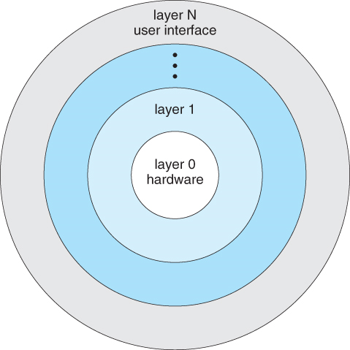
Operating System Structure
2.Layered Approach:
implementation and modification easier,
Because this approach is to break the OS into
number of smaller layers and relies on the
services provided by next lower layer.
(simplicity) allows each layer to be developed and
debugged independently, with assumption
that all lower layers is already debugged.
The problem is deciding what order in which
to place the layers, as no layer can call upon the services of any higher layer(dependency).
Layered approaches can also be less efficient, as a request for service from a higher layer has to filter through all lower layers before it reaches the HW, possibly with significant processing at each step.
where these layers are being used?
Notes:
Loosely coupled: not impacting other parts
Each level layers has specified operations/functions

Slide 41
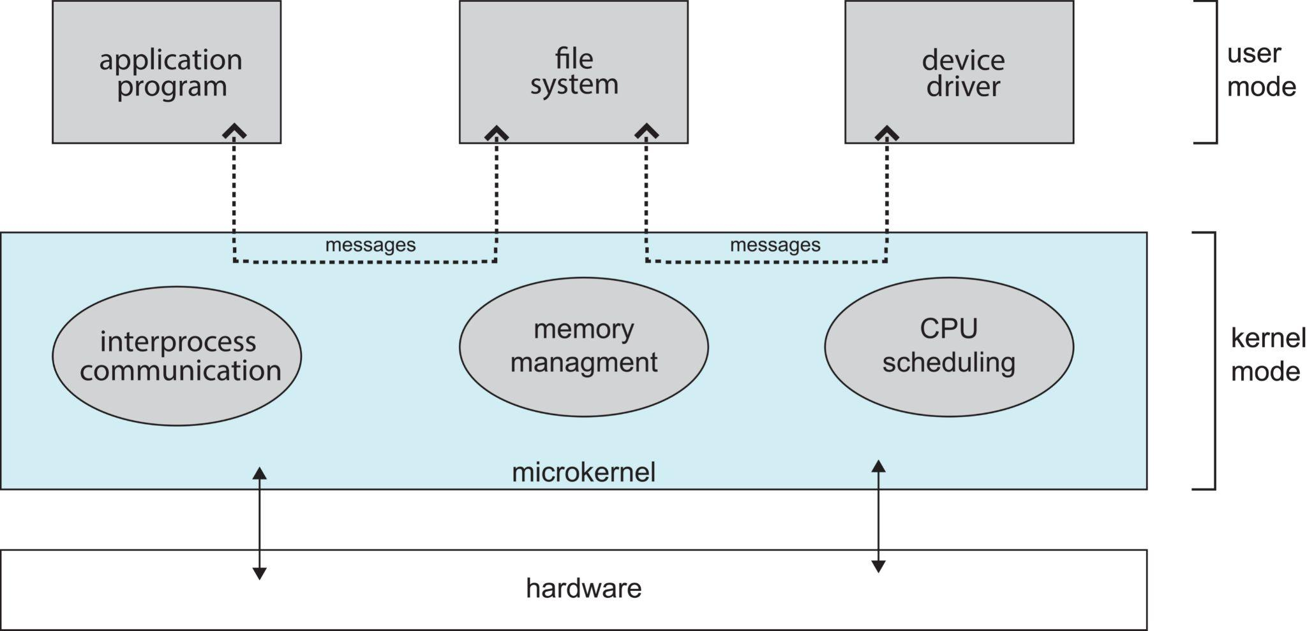
Difference with Layered
Notes:
Unix original system was monolithic structure .
As Unix expanded, the kernel became large and difficult to manage
1980, CMU developed OS named Mach

Slide 42
Operating System Structure
3.Microkernels:
Micro kernels is to remove all non-essential services from the kernel, and implement them as system applications
Provide basic process and memory management, and message passing between other services
Security and protection can be enhanced, as most services are performed in user mode, not kernel mode. (file systems and device driver at user level)
System expansion can also be easier, because it only involves adding more system applications, not rebuilding a new kernel.
Mach, Windows NT are examples of kernel
Notes:
Services /functions/operations are refined
Adaptability: easier to update

Slide 43
It looks like extra context switches and copying would be expensive
Kernel still surprisingly large - “It’s not micro in size, it’s micro in functionality”
When a user needs a service from OS, It uses kerbel IPC service.
The kernel makes sure that the request reaches the desired part of OS.
Advantage:
relatively reliable, easy to secure(why), maintain, modify and port, overall ease to OS, new services are only modified on user level kernel does not have to comply with
Disadvantage:
suffer performance problem due to more time spent on message passing work.
Why this structure is not used in building kernel?

Slide 44
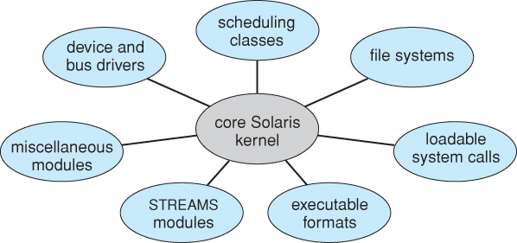
Operating System Structure
4.Modules
Similar to microkernel and layered model.
Modern OS development is object-oriented, with a relatively small core kernel and a set of modules which can be linked in dynamically.
Loadable Kernel Modules (or LKMs for short) are a way to extend a running kernel to deal with something new or unusual.
Modules are similar to layers in that each subsystem has clearly defined tasks and interfaces.
The kernel is relatively small in this architecture, similar to microkernels, but the kernel does not have to implement message passing since modules are free to contact each other directly.
Notes:
Loadable kernel modules(LKMs)
Easy to update due to modules
How a layered system and modules based kernel are similar and dissimilar to each other ?

Slide 45
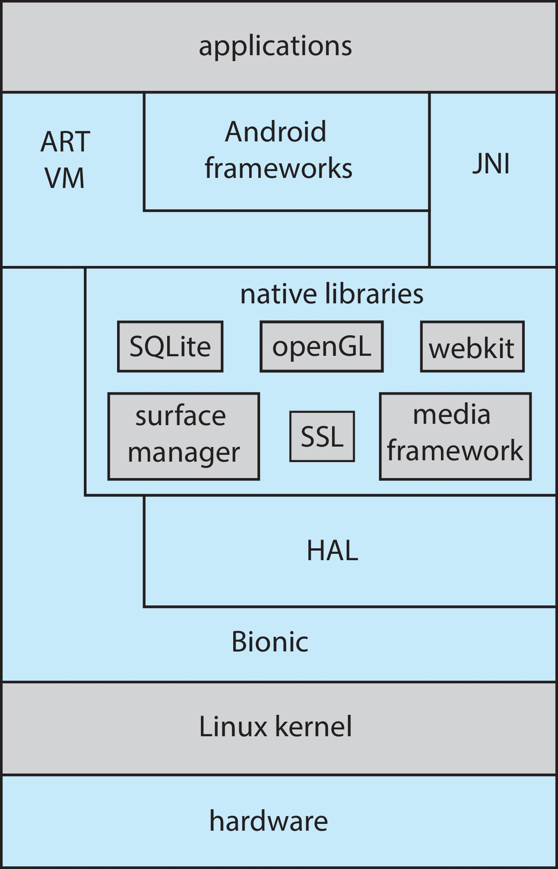
Operating System Structure
5.Hybrid Systems:Most OS today do not strictly
adhere to one architecture, but are hybrids of
several.
Android:
open-source OS
includes versions of Linux
and a JVM
apps are developed using
Java

Slide 46

Architecture of Apple's macOS and iOS operating systems
MacOS and iOS systems have a kernel environment known as Darwin.
Darwin is an example of a hybrid system - a mix of different designs.
It has a Mach micro-kernel and a BSD Unix kernel implemented over the Mach micro-kernel.
Programs can make Mach system calls, and they can also make BSD system calls.

Slide 47
Operating System Generation
SYSGEN program obtains information concerning the specific configuration of the hardware system that is, Systems have to be configured for the specific site to which they are targeted.
OR SYSGen involves simply settings the parameters that describe the system configuration
Example: We perform system generation when we put a new host online, providing at that time, for example, a hostname, host IP address, router IP address.
The SYSGEN information may be incorporated into the source code for the OS, and a custom version of the OS then compiled.
Other SYSGEN operations possible: disk partitioning, installation of device drivers, choice of CPU-scheduling algorithm, and setting of the maximum number of processes to be supported.
Another option, common in PCs, laptops, and mobile devices, is for the system to be pre-compiled and the SYSGEN information saved in the form of tabular information in files, accessed and utilized by the pre-compiled OS in order to achieve the desired customization effects.

Slide 48
Question
The process of starting a computer by loading the kernel is known as ?

Slide 49
Operating-System Debugging
Debugging is finding and fixing errors, or bugs
OS generate log files containing error information
Failure of an application can generate core dump file capturing memory of the process
Operating system failure can generate (kernel)crash dump file containing kernel memory
Kernighan’s Law: “Debugging is twice as hard as writing the code in the first place. Therefore, if you write the code as cleverly as possible, you are, by definition, not smart enough to debug it.”

Slide 50
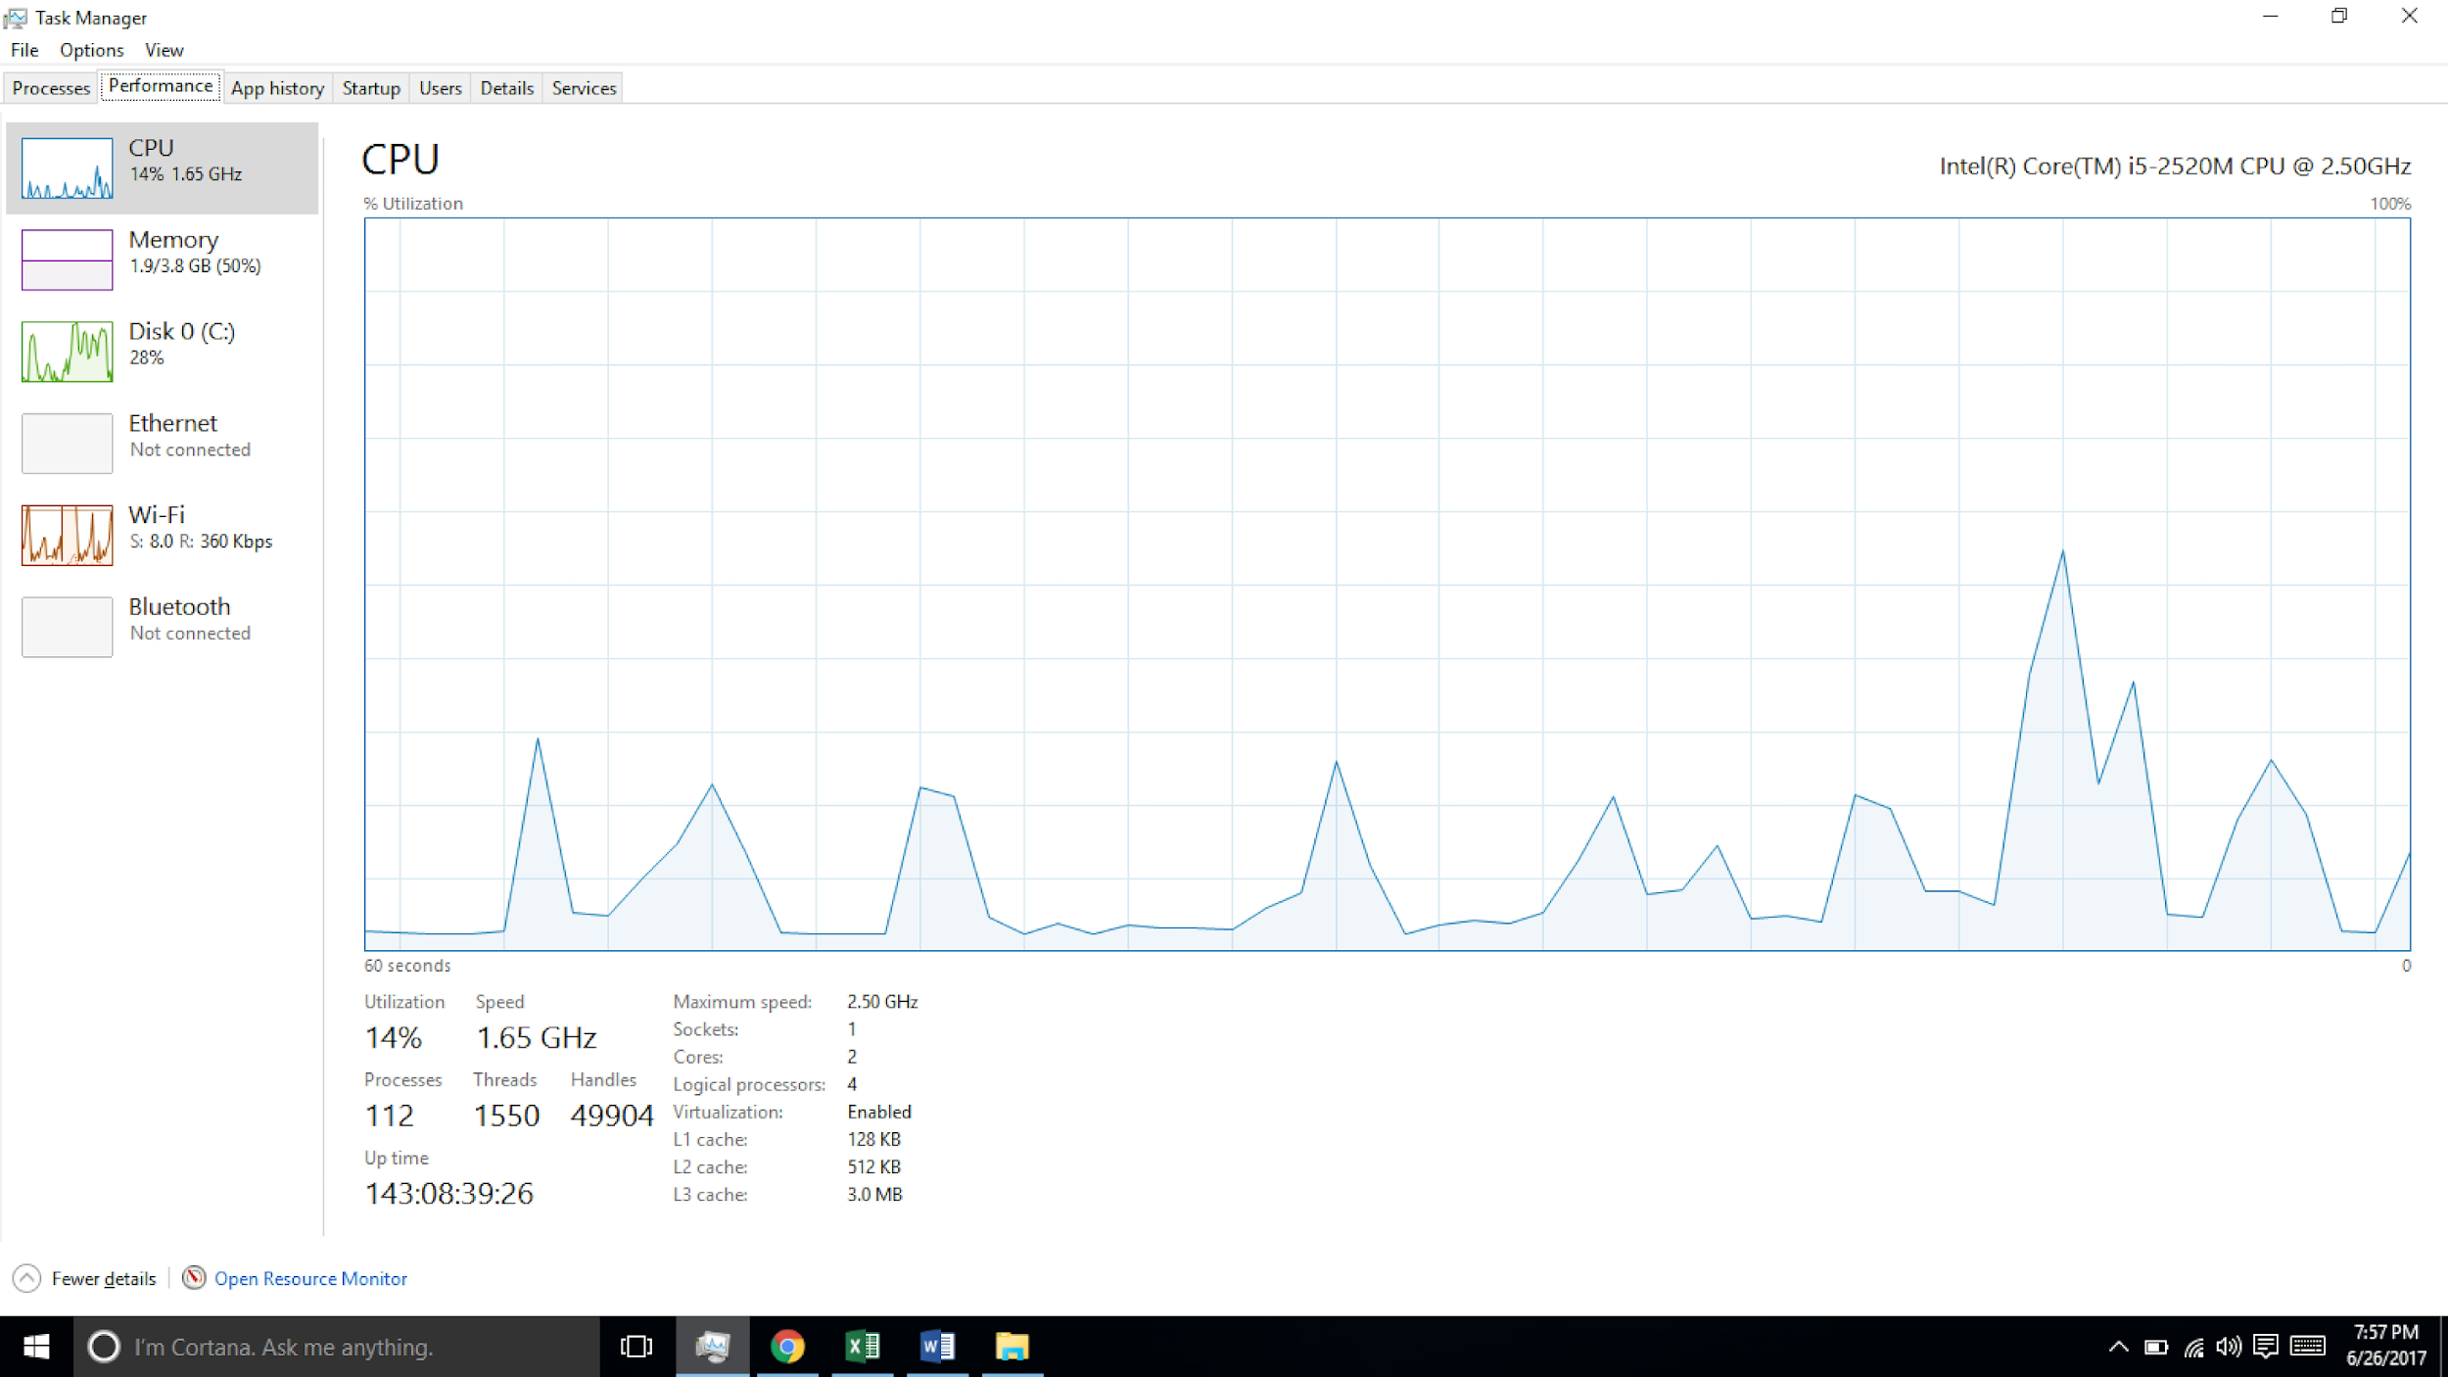
Performance Tuning
Improve performance by removing bottlenecks
OS must provide means of computing and displaying measures of system behavior
For example, “top” program or Windows Task Manager (use counter)
[/proc:process and statistic

Slide 51
Tracing
Collects data for a specific event, such as steps involved in a system call invocation
Tools include
strace – trace system calls invoked by a process
gdb – source-level debugger
perf – collection of Linux performance tools
tcpdump – collects network packets

Slide 52

BCC
Debugging interactions between user-level and kernel code nearly impossible without toolset that understands both and an instrument their actions
BCC (BPF(berkeley packet filter) Compiler Collection) is a rich toolkit providing tracing features for Linux
See also the original DTrace
For example, disksnoop.py traces disk I/O activity
Many other tools (next slide)
Notes:
BPF (Berkeley Packet Filters),

Slide 53
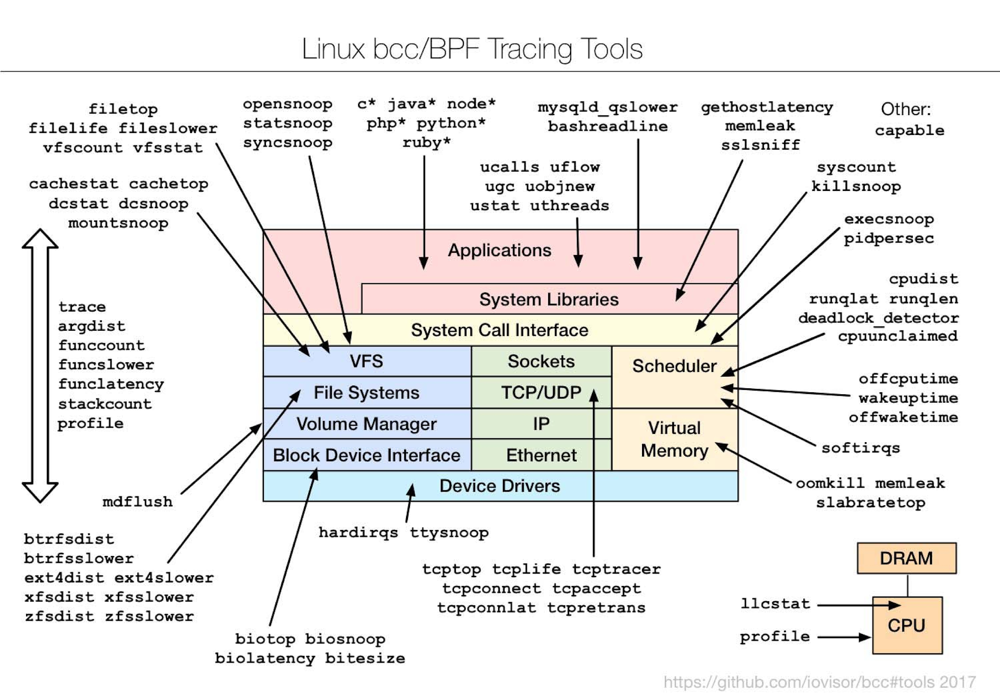
Linux bcc/BPF Tracing Tools
Notes:
https://www.linuxembedded.fr/2019/05/bcc-integration-into-buildroot

